Slide 1
Indexes

Slide 2
Agenda
Index overview
How index make search faster
Types of indexes
Clustered
Non-Clustered
Composite
Filtered
Covering
Column-Store
Row vs Column fashion
Pros and Cons
Maintaining Indexes

Slide 3
Index Overview
To facilitate quick retrieval of data from database, sql server provides the indexing feature.
An index in sql server database contains information that allows you find specific data without scanning through the entire table.
Indexes are created on tables and views.
Index on a table or a view, is very similar to an index that we find in a book.
In fact, the existence of the right indexes, can improve the perform query. If there is no index to help the query, then query engine, checks every row in the table from the beginning to end. This is called as tables scan is very bad for performance.
Sp_helpindex system stored procedure to view the index on a table.
We can have only 1 clustered and 999 non-clustered index in one table, but we can have one clustered index on multiple columns, and that type of index is called composite index.

Slide 4
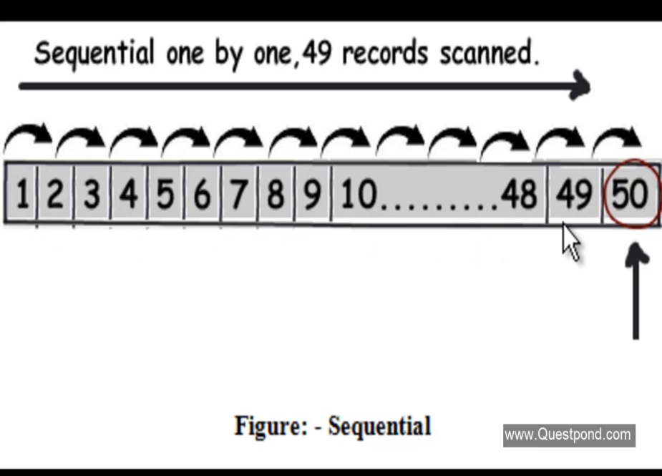
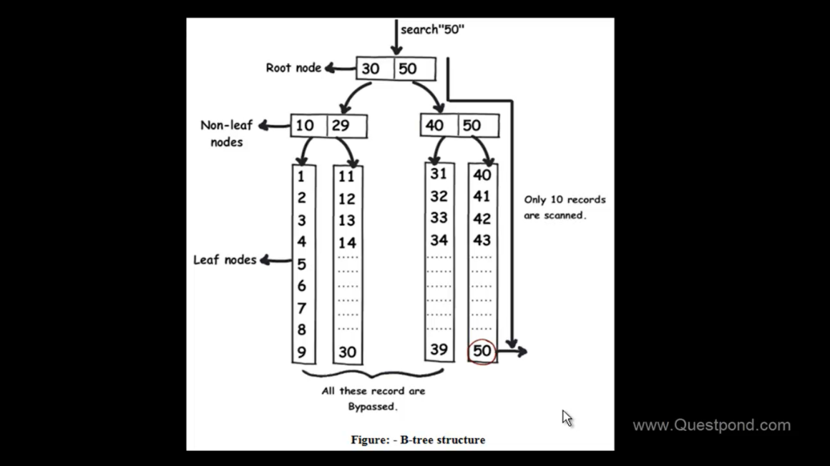
How Index Make Search Faster
Table Scan(Without Index)
Index B-Tree Structure (Index Seek)

Slide 5
Clustered Index
A clustered index causes records to be physically stored in a sorted or sequential order.
A clustered index determines the actual order in which data is stored in the database. Hence, you can create only one clustered index in a table.
Clustered index is as same as dictionary where the data is arranged by alphabetical order.
A clustered index can improve the performance of data retrieval.
Does not required additional disk space.
Use numeric data type as compared to text data type, it will reduce logical reads.
SYNTAX:-
CREATE CLUSTERED INDEX CIX_ID ON TableUser (ID);

Slide 6
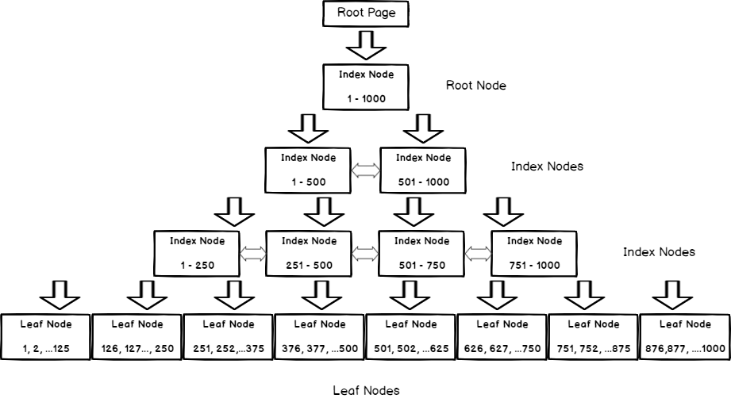
Clustered Index B-Tree Structure

Slide 7
Non-Clustered Index
A non-clustered index is as same as to an index of a book.
The data is stored in one place, and index is stored in another place.
Since, the non-clustered index is stored separately from the actual data, a table can have more than one non-clustered index.
Key lookup
Row ID lookup
SYNTAX:-
CREATE NONCLUSTERED INDEX CIX_ID ON TableUser (ID);

Slide 8
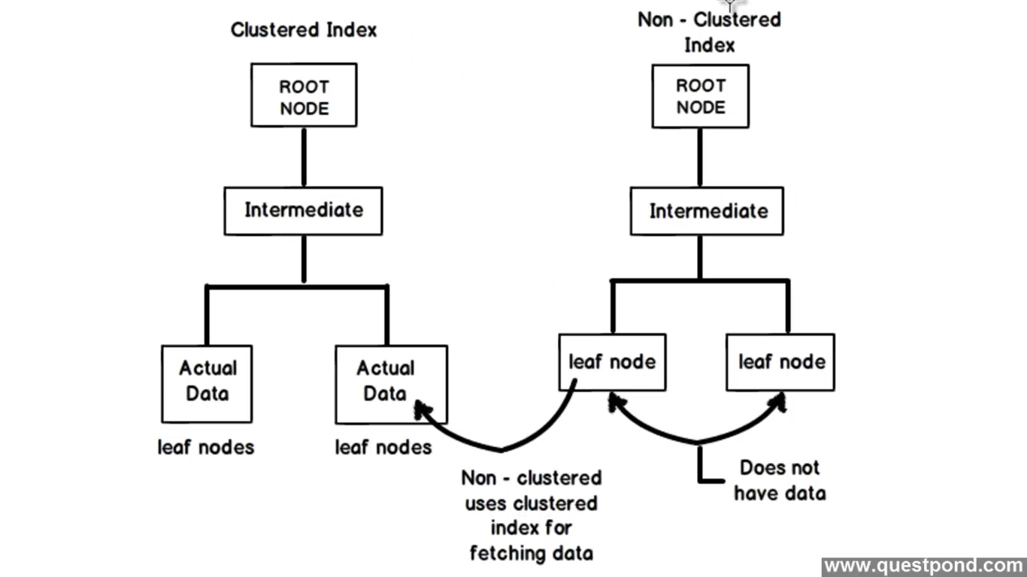
Diference Between Clustered and Non-Clustered Index

Slide 9
Composite Index
An index that contains more than one column.
Both clustered and non-clustered indexes can be composite indexes
SYNTAX:-
CREATE CLUSTERED INDEX CIX_ID ON TableUser (ID,NAME);

Slide 10
Filtered Index
Filtered index (i.E. Index with where clause) is one of the new feature introduced in sql server 2008. It is a non-clustered index, which can be used to index only subset of the records of a table. As it will have only the subset of the records, so the storage size will be less and hence they perform better from performance perspective compared to the classic non-clustered indexes.
SYNTAX:-
CREATE CLUSTERED INDEX CIX_ID ON TableUser (ID) WHERE NAME IS NOT NULL;

Slide 11
Covering Index
Using on ‘include’ clause in non-clustered index provides the ability to cover additional columns in a query select list without needing to access a clustered index to access those columns. Therefore, index can be utilized by wider queries incurring additional key or row ID lookup.
SYNTAX:-
CREATE NONCLUSTERED INDEX CIX_ID ON TableUser (ID) INCLUDE(NAME);

Slide 12
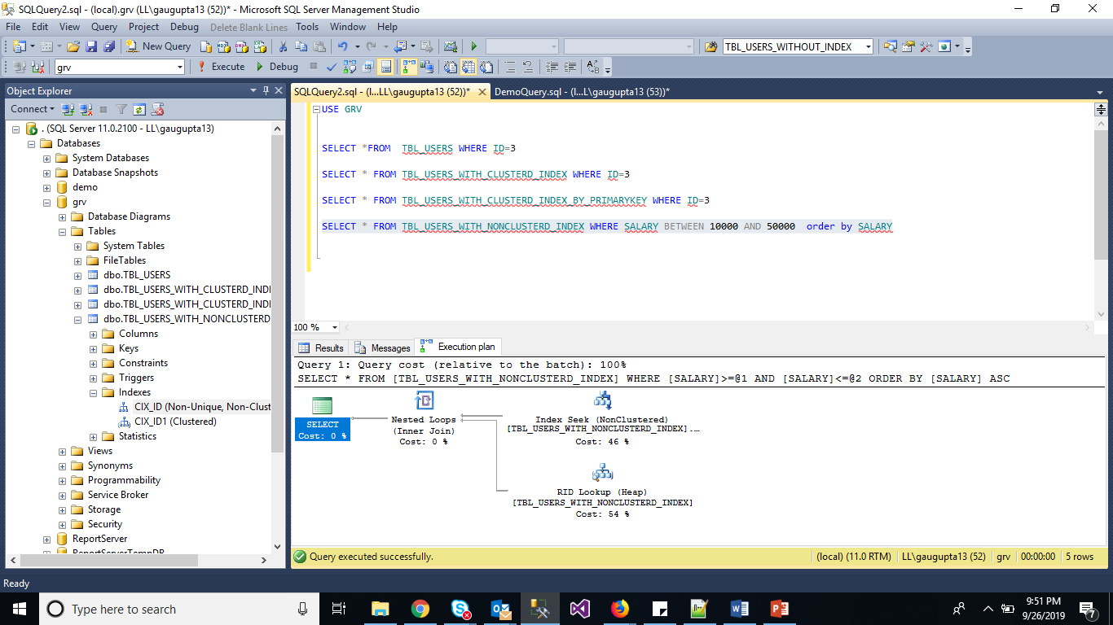
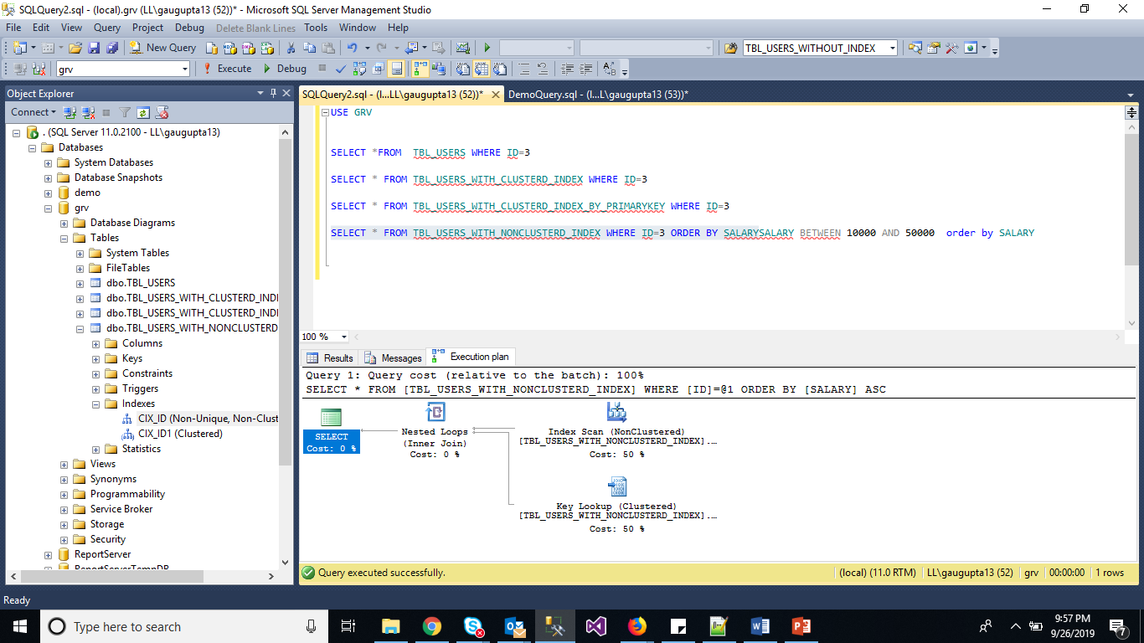
Key and Row ID Lookup

Slide 13
Column-Store Index
In sql server 2012 the new type index introduce columnstore index.
The column-store index is a feature in which the data will be physically organized in columnar data format, unlike traditional row-store technology, with the row-wise format, that is used for storing, managing and retrieving large data using a columnar data format.
The column-store technology, allows you to gain 10x query performance enhancement over the traditional row-wise technology. It also provides you with high level of data compression, reducing the storage required in your data warehouse.
The column-store index performance gain comes from the fact that we usually select a few columns from our table.

Slide 14
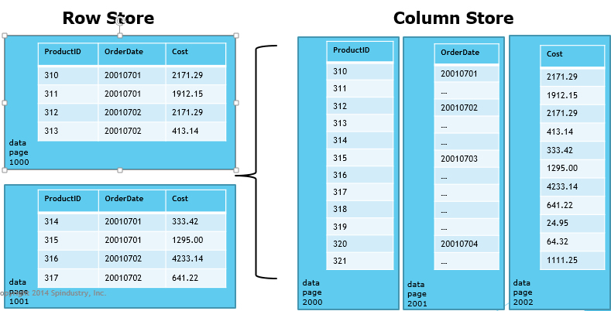
Row vs Column fashion

Slide 15
When to use Index
Create indexes on columns that will be frequently searched against.
An index helps to speed up select queries and where clause, but it slows down data input, with the update and the insert statements.
Indexes can be created or dropped with no effect on the data.
Indexes are automatically created when primary key and unique constraints are defined on a table.

Slide 16
When indexes should be avoided?
Indexes should not be used on small tables.
Tables that have frequent, large batch update or insert operations.
Indexes should not be used on columns that contain a high number of null values.
Columns that are frequently manipulated should not be indexed.

Slide 17
Maintaining Index Part-1
Rebuild Process:-
Rebuild drops the existing index and recreate a brand new index.
Rebuild can run in parallel (enterprise/developer version only), this is a great feature for large table/indexes, so it leverage all cpus and perform the operation faster.
Since rebuild creates a fresh index, thus it creates new and fresh statistics on the underlying index.
If rebuild is performed offline then the index is not available until the rebuild process has completed, and to perform the online rebuild you should have enterprise/developer edition only.
The rebuild is an atomic operation, means if you cancel it in between, it will stop and reflect no changes.
continue….

Slide 18
Maintaining Index Part-2
Reorganize Process:-
It does not drop the index, it just shuffled the leaf pages to remove the fragmentation.
Always single threaded operation.
Reorganized always perform online, thus there is no downtime irrespective of the version and edition of sql server.
A non atomic process, even if you stop the reorganize process in between the operation, it can start from where it left.
If the index is never reorganized, then it can generate lots of logs record because it is fully logged operation.

